Slide 1
University of Basrah
AL-Zahraa College of Medicine
Ministry of higher Education and Scientific Research
Cardiorespiratory Care Block
Lecture title: cardiomyopathies
Date: 3/2/2022
Dr. Mohammed Adel
CRC Block Staff:
Dr Firas Rashid Sayil (block leader)
Dr. Mohammed Adel
Dr Assad Hassan
Dr Ahmed Qassim
Dr Safa Asaad
Dr Mustafa Ghazi
Dr Ilham Mohammed
Dr Zainab Muzahim
Dr. Ahmed Bader
Dr Nawal Mustafa
Dr Zainab Almnaseer
Dr Farqad Alhamdani
Dr Ban M. Saleh
Dr Amani Namaa
References as in the workbook and classroom.
For more detailed instruction, any question, cases need help please contact block leader at the CRC Google classroom or email.

Slide 2
University of Basra
AL-Zahraa College of Medicine
Ministry of higher Education and Scientific Research
Cardiomyopathies
Cardiomyopathies are primary diseases of the myocardium, which are classified according to their effects on cardiac structure and function.
They can be inherited or be caused by infections or exposure to toxins. In some cases no cause is identified.

Slide 3
University of Basra
AL-Zahraa College of Medicine
Ministry of higher Education and Scientific Research
Types of cardiomyopathies:
Dilated cardiomyopathies.
Hypertrophic cardiomyopathies
Restricted Cardiomyopathies
Arythymogenic right ventricle.
Obliterative cardiomyopathies.
Others.

Slide 4
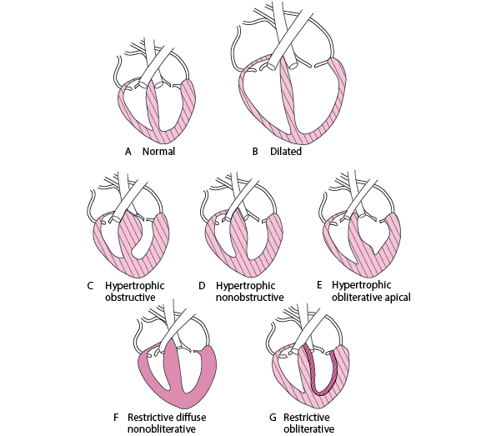
University of Basra
AL-Zahraa College of Medicine
Ministry of higher Education and Scientific Research

Slide 5
University of Basra
AL-Zahraa College of Medicine
Ministry of higher Education and Scientific Research
A 54-year old male self-presented to the emergency department with a 4-day history of awareness of irregularities of his heart rhythm. This was not accompanied by any chest pain but he revealed a one-month history of shortness of breath, tiredness, and leg swelling.
He also reported general malaise and decreased libido. He had recently stopped smoking when the symptoms first started and used to smoke 15 cigarettes a day prior to that for 25 years.
He had no prior medical or surgical history other than mild asthma for which he had not been hospitalized previously.

Slide 6
University of Basra
AL-Zahraa College of Medicine
Ministry of higher Education and Scientific Research
On admission, he was found to have a narrow complex tachycardia, which reverted to normal sinus rhythm with intravenous verapamil.
Initial investigations showed Troponin I of 0.22 (normal < 0.04), a BNP of 899 (normal < 100), and raised D-dimers of 664. A CT pulmonary angiogram excluded a pulmonary embolus.
A transthoracic echocardiogram showed mildly dilated left and right ventricles with global hypokinesia and severe biventricular systolic dysfunction.
The left ventricular ejection fraction (LVEF) was calculated, by Simpson’s method, to be 15% (normal > 55%).
A full cardiomyopathy biomarker screen was negative for any secondary causes.

Slide 7
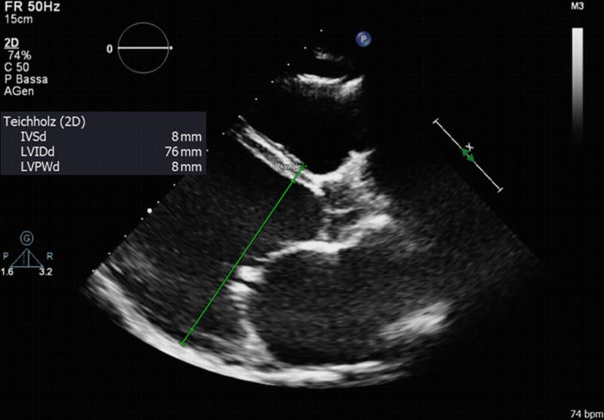
University of Basra
AL-Zahraa College of Medicine
Ministry of higher Education and Scientific Research

Slide 8
University of Basra
AL-Zahraa College of Medicine
Ministry of higher Education and Scientific Research
Q1. what’s your diagnosis?
Q2. what are the clinical features of the disease?
Q3. how do you investigate ?
Q4. how do you treat such patient?

Slide 9
University of Basra
AL-Zahraa College of Medicine
Ministry of higher Education and Scientific Research
Dilated Cardiomyopathies
Cardiomyopathy is characterised by dilatation and impaired contraction of the LV and often the RV. Left ventricular mass is increased but wall thickness is normal or reduced.
Dilatation of the valve rings can lead to functional mitral and tricuspid incompetence.
Histological changes are variable but include myofibrillary loss, interstitial fibrosis and T-cell infiltrates.
The term ‘dilated cardiomyopathy’ encompasses a heterogeneous
group of conditions

Slide 10
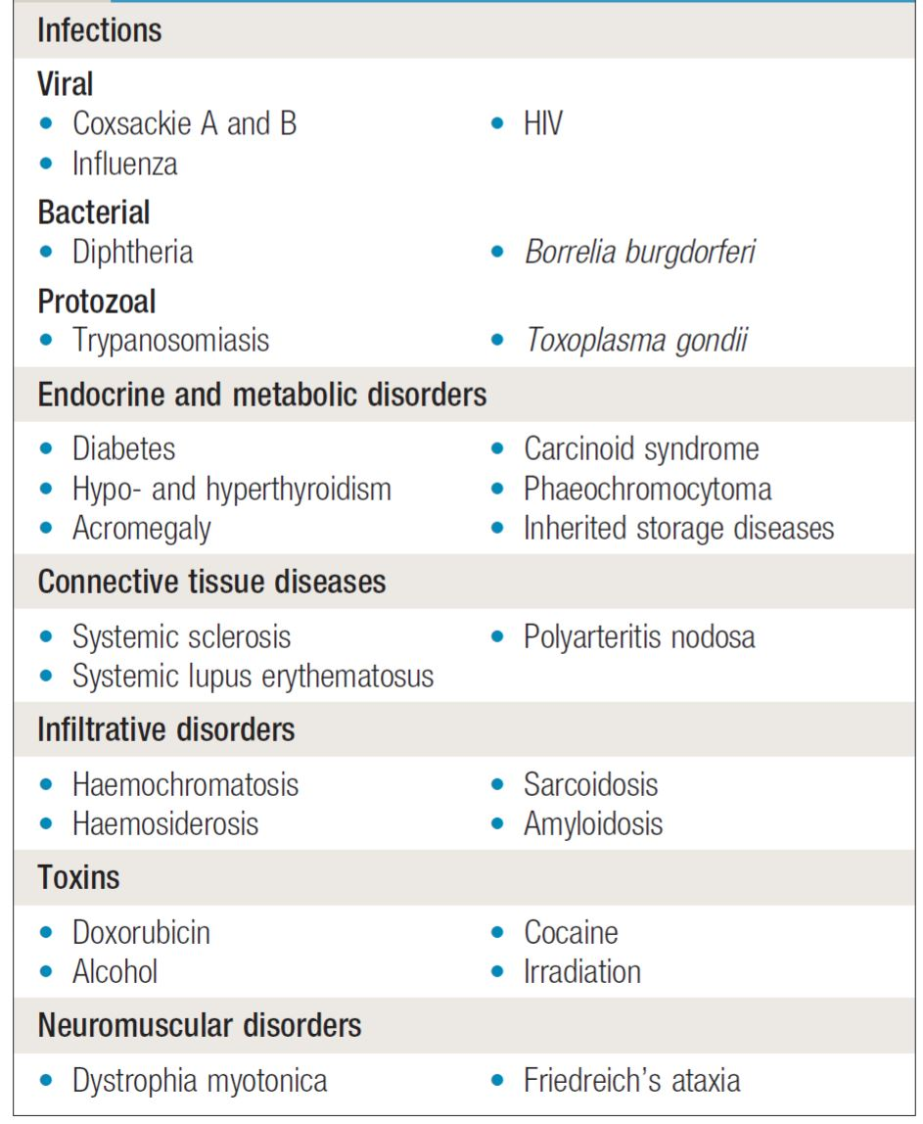
University of Basra
AL-Zahraa College of Medicine
Ministry of higher Education and Scientific Research
Secondary causes of cardiomyopathies:

Slide 11
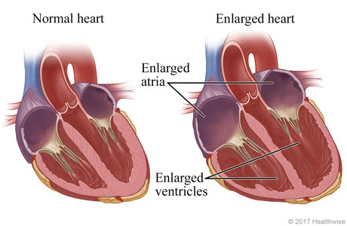
University of Basra
AL-Zahraa College of Medicine
Ministry of higher Education and Scientific Research

Slide 12
University of Basra
AL-Zahraa College of Medicine
Ministry of higher Education and Scientific Research
Alcohol may be an important cause in some patients.
At least 25% of cases are inherited as an autosomal dominant trait and a variety of single-gene mutations have been identified.
Most of these mutations affect proteins in the cytoskeleton of the myocytes, such as dystrophin, lamin A and C, emerin and metavinculin.
most of the X-linked inherited skeletal muscular dystrophies, such as Becker and Duchenne (p. 1143), are associated with cardiomyopathy.
a late autoimmune reaction to viral myocarditis is thought to be the cause in a substantial subgroup of patients with dilated cardiomyopathy; a similar mechanism is believed to be responsible for the myocardial involvement that occurs in up to 10% of patients with advanced human immunodeficiency virus (HIV) infection.

Slide 13
University of Basra
AL-Zahraa College of Medicine
Ministry of higher Education and Scientific Research
Clinical features
Most patients present with heart failure or are found to have the condition during routine investigation. Arrhythmia, thromboembolism and sudden death may occur at any stage; sporadic chest pain is a surprisingly frequent symptom.
The differential diagnosis includes ventricular dysfunction due to CAD, and a diagnosis of dilated cardiomyopathy should be made only when this has been excluded.

Slide 14
University of Basra
AL-Zahraa College of Medicine
Ministry of higher Education and Scientific Research
Investigations:
Echocardiography and cardiac MRI are the most useful investigations. Although ECG changes are common, they are non-specific. Genetic testing is indicated if more than one family member is diagnosed with the condition.
Treatment:
Same as heart failure with reduced ejection fraction.
Consider heart transplant.
What are the indication of CRT , ICD

Slide 15
University of Basra
AL-Zahraa College of Medicine
Ministry of higher Education and Scientific Research
31 years old male admitted to the CCU with history of shortness of breath and chest pain for 3 days duration. Paatient was admitted from the ER as case of ACS
However, after thorough history the positive finding were :
Previous hospital admission for same problem
Previous syncope multiple times
No history of HTN, DM, anaemia
Family history was significant for a brother who died suddenly at age of 24
And father with history of congenital heart diease
Patient is non smoker, nor alcoholic and no history of substance abuse.

Slide 16
University of Basra
AL-Zahraa College of Medicine
Ministry of higher Education and Scientific Research
General physical examination was unremarkable
Pericordial examination reveal:
Apex beat located at 5th intercostal space midclavicular line.
Double apex beat. Normal S1, loud S2 , S4 is present
Crescendo decrescendo systolic murmur at left lower parasternal area
ECH ---LVH with inferior leads pathological Q wave.
CXR was relatively normal
Echo ----

Slide 17
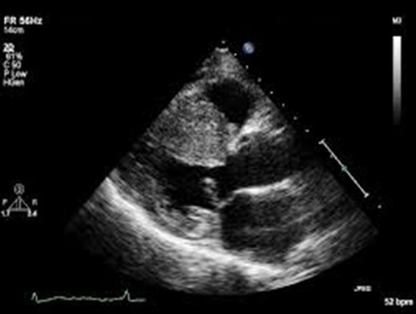
University of Basra
AL-Zahraa College of Medicine
Ministry of higher Education and Scientific Research

Slide 18
University of Basra
AL-Zahraa College of Medicine
Ministry of higher Education and Scientific Research
What’s your diagnosis?
How do you approach ?
What are the ECG feature?
What are the ECHO features of this disease?
Does this patient is indicated for ICD?
What’s your management plane?

Slide 19
University of Basra
AL-Zahraa College of Medicine
Ministry of higher Education and Scientific Research
Hypertrophic cardiomyopathies
Hypertrophic cardiomyopathy (HCM) is a genetically determined heart muscle disease most often caused by mutations in one of several sarcomere genes that encode components of the contractile apparatus. (often inherited a AD disease)
HCM is characterized by left ventricular hypertrophy (LVH) of various morphologies, with a wide array of clinical manifestations and hemodynamic abnormalities Depending in part upon the site and extent of cardiac hypertrophy

Slide 20
University of Basra
AL-Zahraa College of Medicine
Ministry of higher Education and Scientific Research
patients with HCM can develop one or more of the following abnormalities:
LV outflow obstruction
Diastolic dysfunction
Myocardial ischemia
Mitral regurgitation
In broad terms, the symptoms related to HCM can be categorized as those related to heart failure (HF), chest pain, or arrhythmias. For the majority of patients with HCM,

Slide 21
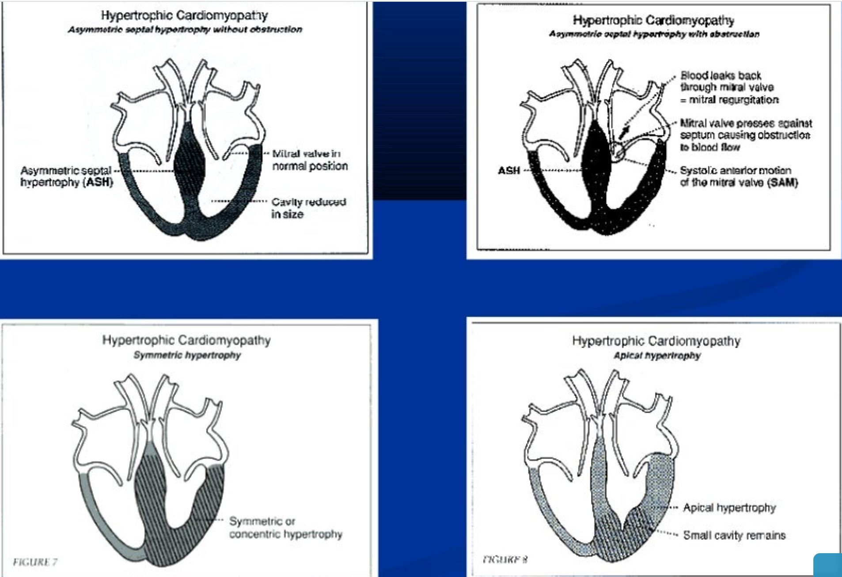
University of Basra
AL-Zahraa College of Medicine
Ministry of higher Education and Scientific Research

Slide 22
University of Basra
AL-Zahraa College of Medicine
Ministry of higher Education and Scientific Research
Clinical presentation:
Dyspnoea (90%), orthopnoea and PND
Palpitation
CHF
Angina (70-80%)
Syncope and presyncpe
Sudden cardiac can be the first clinical manifestation

Slide 23
University of Basra
AL-Zahraa College of Medicine
Ministry of higher Education and Scientific Research
Physical examination:
Carotid pulse (bifid )
JVP (prominent a wave )
Apical beat ( double or triple)
Heart sound:
S1 normal
S2 usually split (reverse )
S3 indicate late stage
S4 usually due hypertrophy
Murmer:
Medium pitch crescendo decrescendo LLSB and apex radiate to suprasternal notch.
SAM with MR

Slide 24
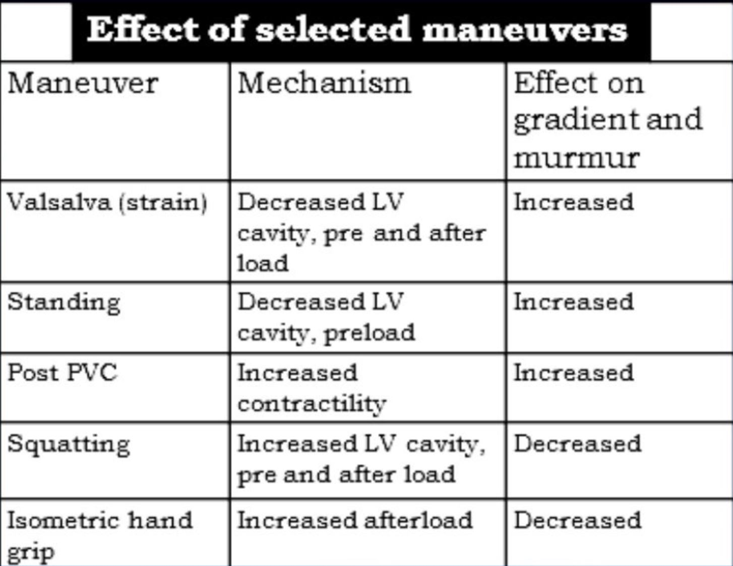
University of Basra
AL-Zahraa College of Medicine
Ministry of higher Education and Scientific Research
Dynamic maneuverer:
Murmur intensity increase with decrease preload (Valsalva, standing )
Murmur intensity decrease with increase preload (squatting , hand grip)

Slide 25
University of Basra
AL-Zahraa College of Medicine
Ministry of higher Education and Scientific Research
Diagnosis:
ECG.
Echocardiography.
Catheterization.
Cardiac imaging.
Evaluation:
Family screen
Holter monitor
Exercise test

Slide 26
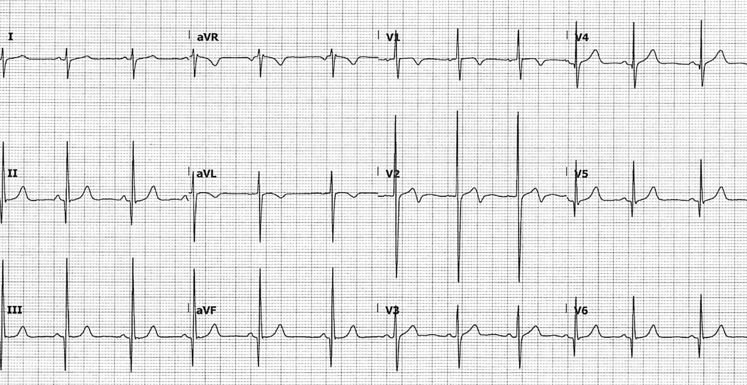
University of Basra
AL-Zahraa College of Medicine
Ministry of higher Education and Scientific Research
ECG features:
Left ventricular hypertrophy with increased precordial voltages and non-specific ST segment and T-wave abnormalities
Deep, narrow (“dagger-like”) Q waves in lateral (I, aVL, V5-6) +/- inferior (II, III, aVF) leads
others

Slide 27
University of Basra
AL-Zahraa College of Medicine
Ministry of higher Education and Scientific Research
Echo features:
Abnormal systolic motion of anterior leaflet of the mitral valve
LVH
Left atrial enlargement
Diastolic dysfunction
Small ventricular chamber size
Septal wall hypertropthy
Partial closure of the aortic valve in midsystole

Slide 28
University of Basra
AL-Zahraa College of Medicine
Ministry of higher Education and Scientific Research

Slide 29
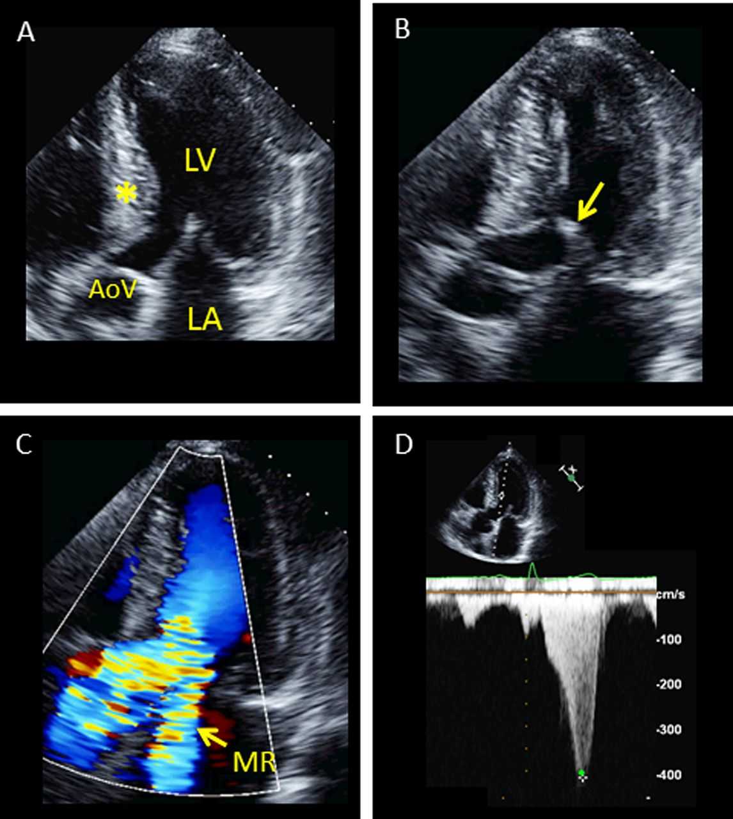
University of Basra
AL-Zahraa College of Medicine
Ministry of higher Education and Scientific Research

Slide 30
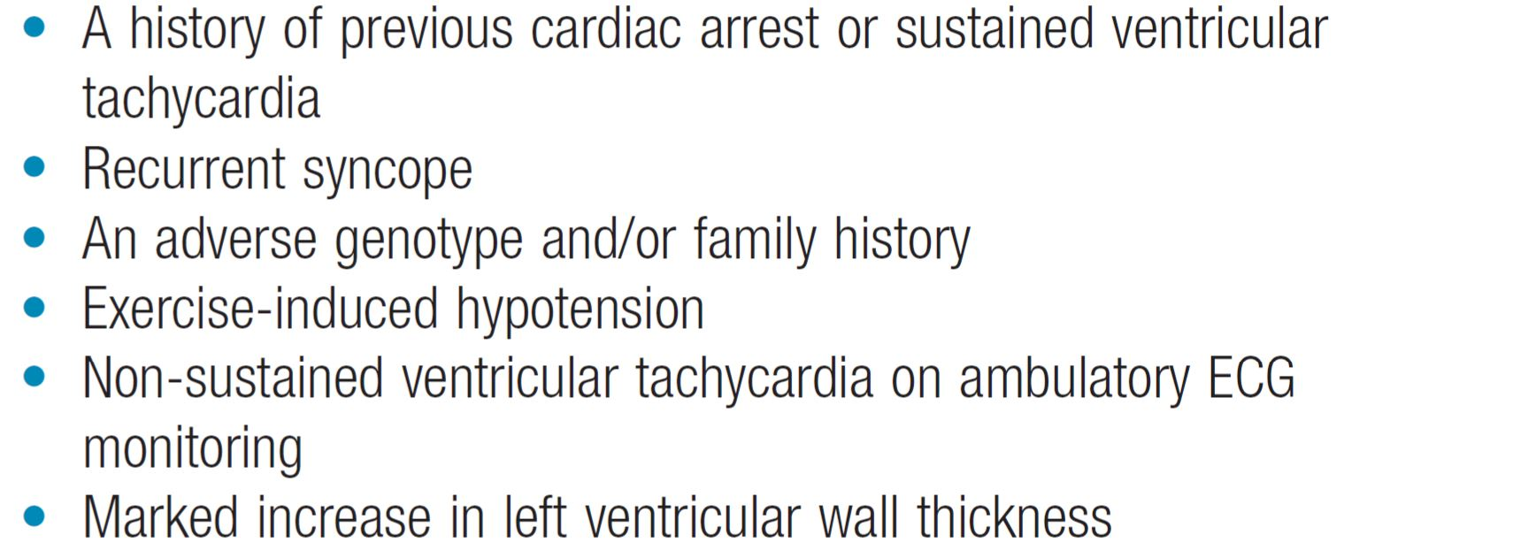
University of Basra
AL-Zahraa College of Medicine
Ministry of higher Education and Scientific Research
Poor prognostic features (indication of ICD in HCM)

Slide 31
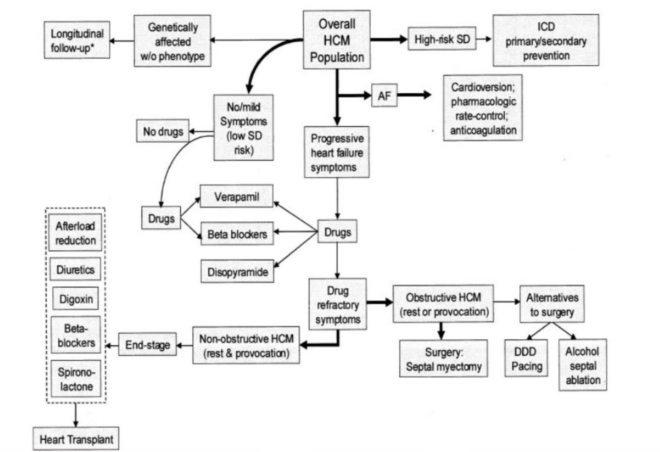
University of Basra
AL-Zahraa College of Medicine
Ministry of higher Education and Scientific Research
Management of HCM:

Slide 32
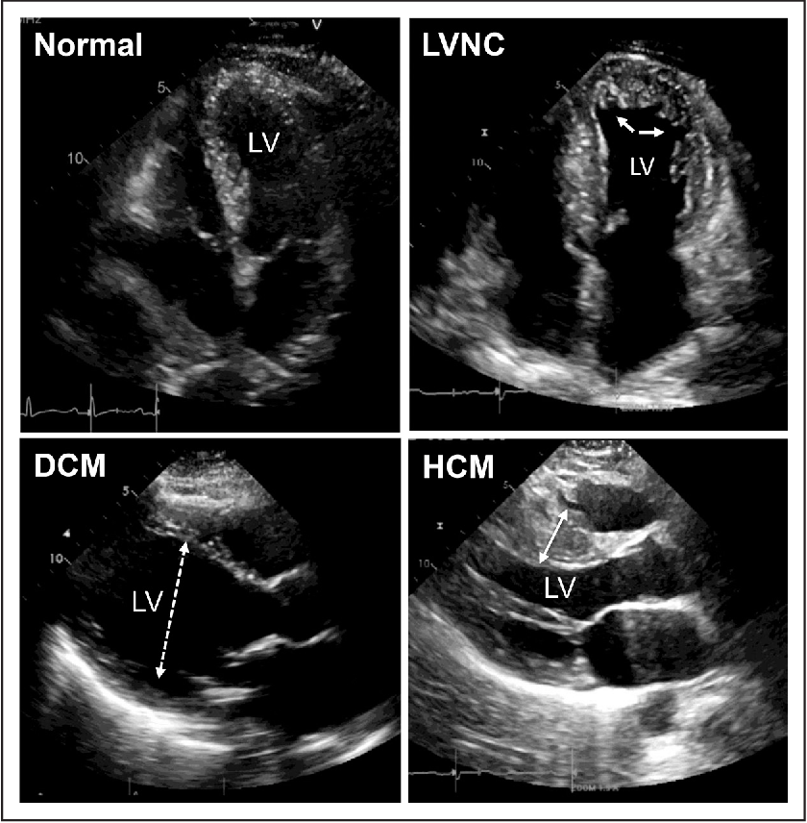
University of Basra
AL-Zahraa College of Medicine
Ministry of higher Education and Scientific Research

Slide 33
University of Basra
AL-Zahraa College of Medicine
Ministry of higher Education and Scientific Research
Restrictive cardiomyopathies:
In this rare condition, ventricular filling is impaired because the ventricles are ‘stiff’ This leads to high atrial pressures with atrial hypertrophy, dilatation and, later, AF.
Amyloidosis is the most common cause in the UK, although other forms of infiltration due to glycogen storage diseases, idiopathic perimyocyte fibrosis and a familial form of restrictive cardiomyopathy can also occur.
RCM is characterized histologically by patchy interstitial fibrosis and myocyte disarray, which are also seen in HCM. With increasing interstitial fibrosis, resulting in increased pressure during normal diastolic filling.

Slide 34
University of Basra
AL-Zahraa College of Medicine
Ministry of higher Education and Scientific Research
The diagnosis of RCM should be suspected in patients when echocardiography demonstrates bi-atrial enlargement and severe diastolic dysfunction in the setting of normal ventricular size, wall thickness, and systolic function.
The diagnosis can be difficult and requires assessment with Doppler echocardiography, CT or MRI, and endomyocardial biopsy.
Treatment is symptomatic but the prognosis is usually poor and transplantation may be indicated.

Slide 35
University of Basra
AL-Zahraa College of Medicine
Ministry of higher Education and Scientific Research
What’s the differences between restrictive cardiomyopathies and constrictive pericarditis ?

Slide 36
University of Basra
AL-Zahraa College of Medicine
Ministry of higher Education and Scientific Research
Takotsubo cardiomyopathy (broken heart syndrome):
Takotsubo cardiomyopathy (Takotsubo syndrome) is a form of acute left ventricular dysfunction characterised by dilatation of the left ventricular apex and adjacent myocardium, with associated left ventricular impairment.
It is often associated with acute environmental or emotional stress (such as a bereavement) and presents with chest pain, breathlessness and sometimes cardiac failure. It occurs more frequently in women than in men.

Slide 37
University of Basra
AL-Zahraa College of Medicine
Ministry of higher Education and Scientific Research
In terms of both symptoms and the ECG, the condition mimics acute ST elevation acute coronary syndrome.
Left ventricular dysfunction usually recovers within 4–5 days, although this can take weeks in some cases. Treatment is with a β-blocker, to prevent arrhythmia, and an ACE inhibitor, to treat left ventricular dysfunction. These drugs are continued only until cardiac function has recovered.

Slide 38
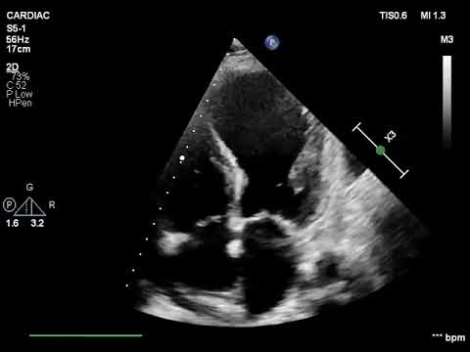
University of Basra
AL-Zahraa College of Medicine
Ministry of higher Education and Scientific Research

Slide 39
University of Basra
AL-Zahraa College of Medicine
Ministry of higher Education and Scientific Research
Thank you

